Slide 1

Geb
BIOFUELS
Employee Wellness Program
Sneak Peak

Slide 2

New Wellness Program
Geb BioFuels will be implementing its new Wellness Program in January with the purpose of providing resources and opportunities for employees to improve and enhance their overall health.
Take a Sneak Peek at the Features!

Slide 3

Duke Health and Wellness Screenings
Screenings for Blood Pressure, Cancer, Heart Attack/Stroke Risk, Diabetes and more
Provided by Duke University Hospital Community Outreach and Health Education Programs

Slide 4

Healthy Weight Seminars
Nutrition education
Healthy food preparation
Food shopping Tips
Responsible weight loss planning
Tips for long-term weight management

Slide 5
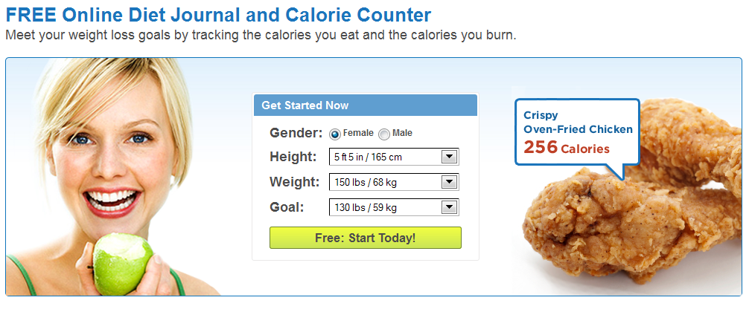
Web Tools for Tracking Your Health Goals
Learn about free online tools that can help you keep track of your goals

Slide 6

Stress Management Tips
Relaxation Techniques
Positive Communication
Time Management
Establishing Priorities
Conflict Resolution
Counseling Programs

