Slide 1
Shelbyfield Animal Rescue
Adoptable Pets

Slide 2
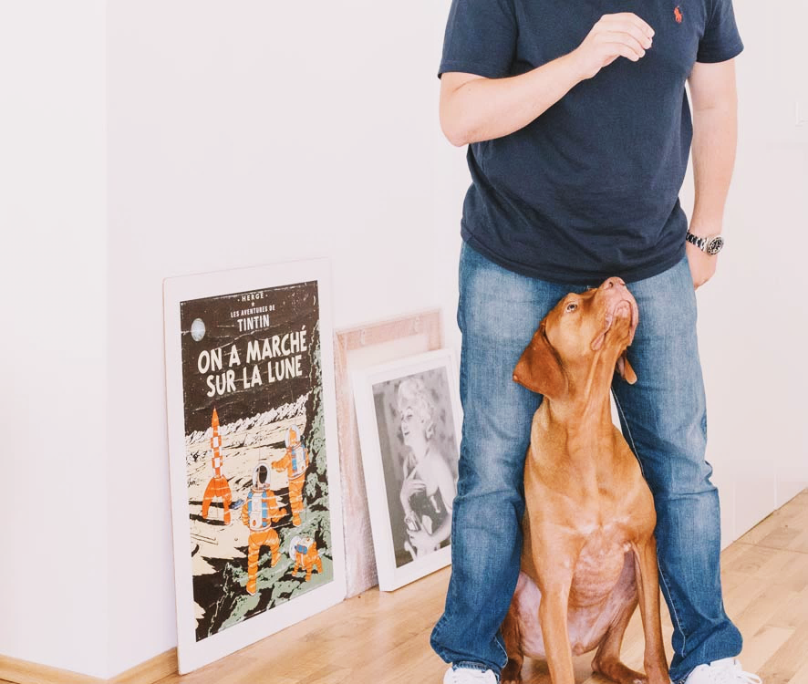
Our Mission
…to rescue, rehabilitate, and re-home stray or unwanted pets.
The volunteers of Shelbyfield Animal Rescue are dedicated to helping animals in need and finding you the perfect pet for your home.

Slide 3
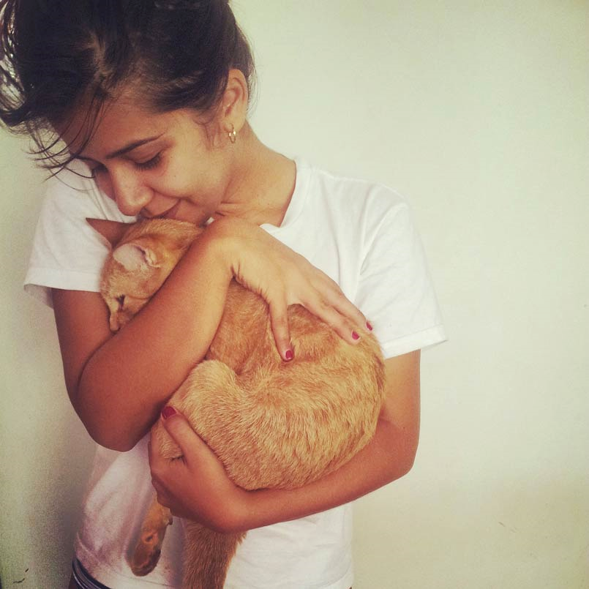
Did you know?
Pet owners experience benefits such as:
Companionship
Social opportunities
Exercise
Stress relief
Lower blood pressure

Slide 4

Pogo
Lab mix Female
5 mos. old 19 lbs.
Likes: Long walks on the beach
Dislikes: Drama

Slide 5
All Warm and Fuzzy Inside
Benefits of Pet Ownership

Slide 6
Man’s Best Friend
Adoptable Dogs

Slide 7

Flapjack
Whippet Male
9 mos. old 23 lbs.
Likes: Literature, philosophy
Dislikes: Misspelled words

Slide 8

Mr. Wilson
Pug Male
6 yrs. old 21 lbs.
Likes: Plaid
Dislikes: The outdoors

Slide 9
The Little Things in Life
Cats and Other Small Pets

Slide 10
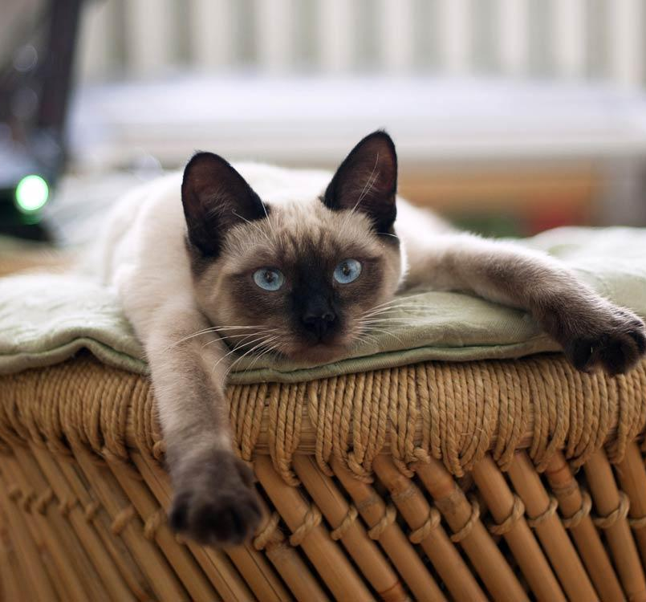
Loaf
Siamese Female
4 yrs. old 8 lbs.
Likes: Watching TV
Dislikes: Sharing the remote

Slide 11
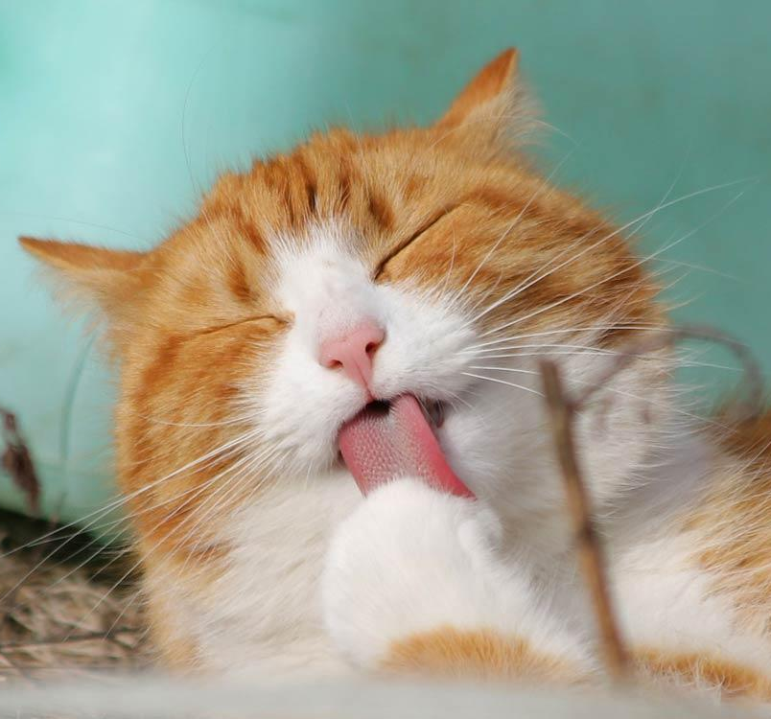
Arbuckle
Orange tabby Male
2 yrs. old 10 lbs.
Likes: Lasagna
Dislikes: Mondays

Slide 12
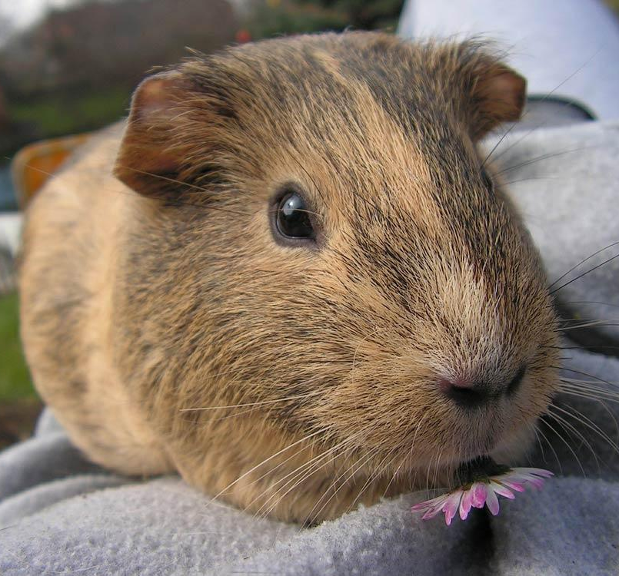
Egg
Guinea pig Female
1.5 yrs. old 2 lbs.
Likes: Math
Dislikes: Sports

Slide 13
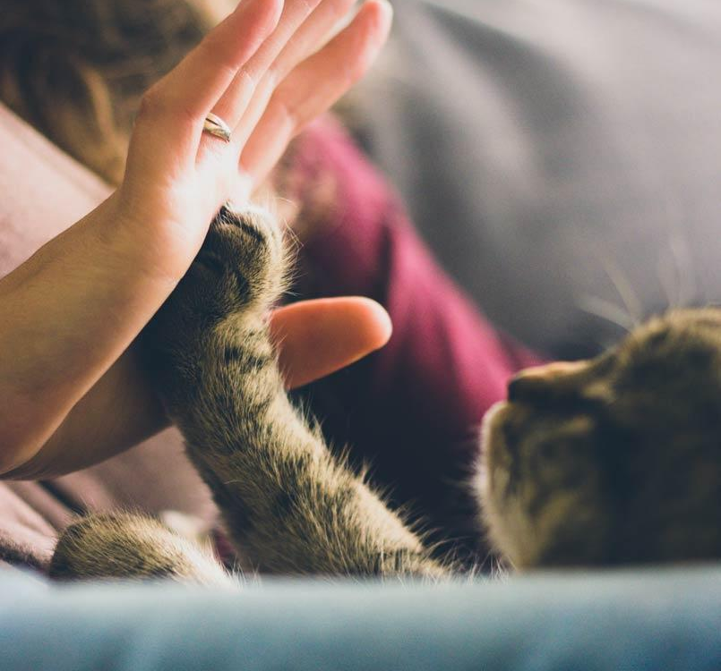
Contact Us
Shelbyfield Animal Rescue
info@shelbyfieldrescue.com
321-555-3746
Shelter Hours
Monday – Saturday
10:00 AM – 6:00 PM

